Slide 1


FINAL YEAR PROJECT PHASE 2
High Speed Visual Navigation for the Visually Impaired with Real Time Mapping and Voice Interaction

Slide 2

CONTENTS
INTRODUCTION
PROBLEM STATEMENT
LITERATURE SURVEY
OBJECTIVES
METHODOLOGY
RESULTS
CONCLUSION
REFERENCES

Slide 3


INTRODUCTION
Navigating independently in unfamiliar environments: Poses significant challenges for visually impaired individuals.
Vision impairment statistics: Approximately 2.2 billion people globally have a vision impairment or blindness, according to the World Health Organization.
Impact on daily tasks and quality of life: A significant number of visually impaired individuals struggle with everyday tasks such as navigating through public spaces.
Project aim: To develop a navigation assistant that leverages advanced technologies for object detection and speech recognition.
Objective: To aid visually impaired users by providing real-time guidance and enhancing their ability to navigate safely and independently.
Traditional mobility aids and limitations: Canes can only detect obstacles on the ground or within immediate reach, missing higher obstacles or objects at a distance.

Slide 4
INTRODUCTION
Guide dogs: While highly effective, guide dogs come with high costs and long waiting times, making them inaccessible to many.
Existing electronic aids: Often lack the capability to provide detailed, real-time information about the user's surroundings, limiting their usefulness.
Need for an intelligent system: There is a clear need for an intelligent system that can dynamically assist visually impaired individuals.
System capabilities: Identifying and locating objects in real-time, while communicating this information effectively through audio feedback.
Potential impact: Enhancing the independent mobility and situational awareness of visually impaired individuals.
Enabling navigation with confidence: Allowing visually impaired users to navigate unfamiliar environments with greater confidence and safety.
.

Slide 5
PROBLEM STATEMENT
There is a pressing need for an intelligent, cost-effective system that can dynamically assist visually impaired users in identifying and locating objects in real time while communicating this information effectively through audio feedback.
Such a system would enhance the independent mobility and situational awareness of visually impaired individuals, enabling them to navigate unfamiliar environments with greater confidence and safety.

Slide 6

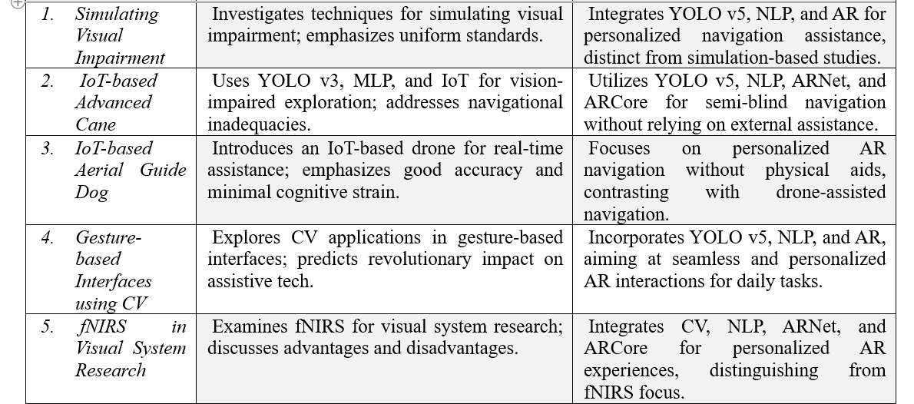
GAPS IN LITERATURE SURVEY

Slide 7
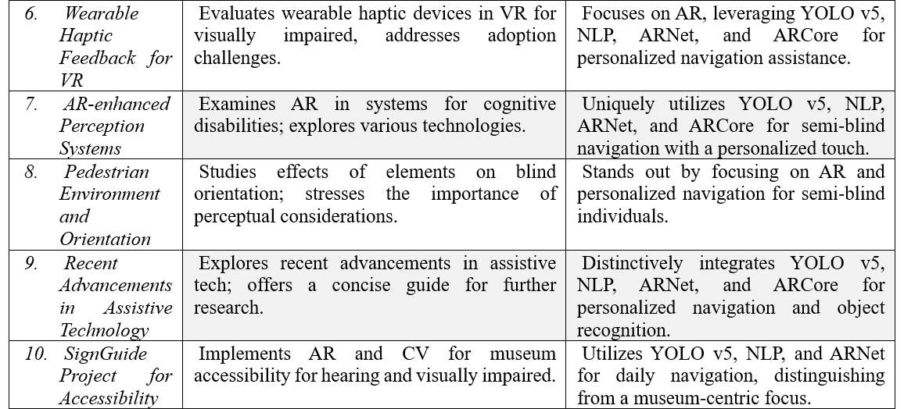
GAPS IN LITERATURE SURVEY

Slide 8
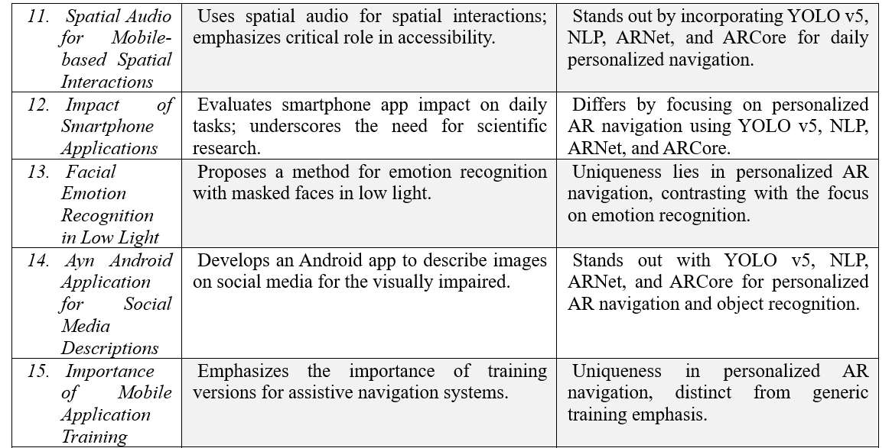
GAPS IN LITERATURE SURVEY

Slide 9
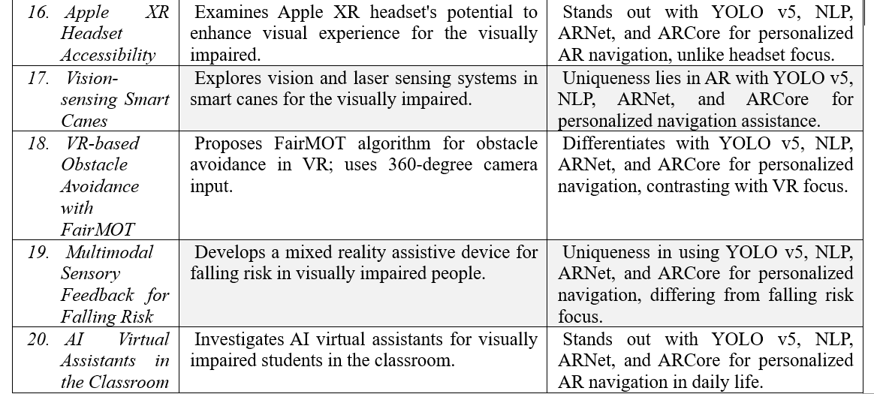
GAPS IN LITERATURE SURVEY

Slide 10
OBJECTIVES
To Develop an Intelligent Navigation Assistant: Leverage advanced computer vision and speech recognition technologies to aid visually impaired users in navigating their environment.
To Enhance Independent Mobility: Provide real-time object detection and audio feedback, helping users navigate safely and independently.
To Create an Intuitive Interface: Develop a user-friendly system that allows interaction through voice commands, ensuring accessibility for users of all technological proficiencies.
To Improve Situational Awareness: Enable users to receive detailed information about objects and obstacles in their path, enhancing their overall awareness and confidence in navigating unfamiliar spaces.
To Ensure Cost-Effectiveness: Develop a solution that is affordable and easy to maintain, making it accessible to a broader population of visually impaired individuals.
To Promote Inclusivity and Accessibility: Contribute to the development of assistive technologies that empower individuals with visual impairments, fostering greater inclusivity and equal opportunities.

Slide 11
METHODOLOGY
Overall approach and design: The project utilizes a Python script that integrates speech recognition, text-to-speech, and object detection functionalities.
Object detection module: Employs OpenCV and a pre-trained Caffe model for real-time object detection in video streams.
Speech recognition and text-to-speech module: Enables user interaction through spoken commands and provides verbal responses using respective libraries.
User interaction module: Facilitates user interaction via spoken commands captured by the smartphone's microphone.
Voice command processing: Users can issue commands like "find [object]" to trigger object detection for specific objects of interest.
Video processing and display module: Captures video streams from the smartphone's camera and processes frames for object detection and display.

Slide 12
METHODOLOGY
Audio feedback: Provides verbal feedback on the location (degree and direction) of detected objects using text-to-speech.
Exception handling: Implements exception handling to address potential errors during speech recognition and other operations.
Data set explanation: Describes the rich and varied dataset used for training the object detection model, comprising annotated images from indoor and outdoor environments.
Algorithms and techniques: Employs the Single Shot Multibox Detector (SSD) algorithm, Convolutional Neural Networks (CNNs), and the Caffe framework for object detection.
Hardware requirements: Utilizes a smartphone as the primary hardware, leveraging its camera and processing power.
Software requirements: Requires a mobile operating system, development framework, tools, and libraries for image processing, object detection, speech recognition, and text-to-speech conversion.

Slide 13
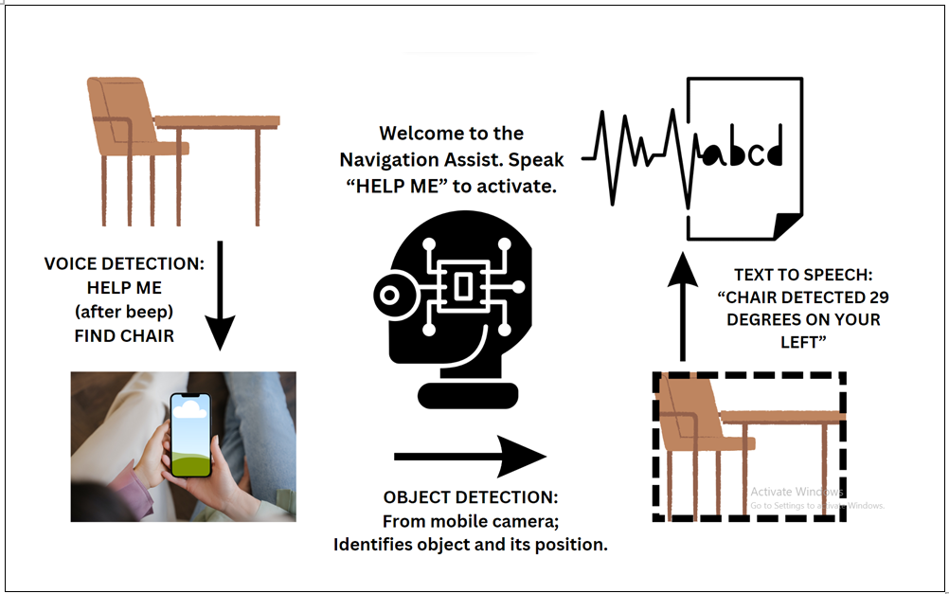

Slide 14
RESULTS
Successful object detection and localization: The system accurately detects and localizes objects specified by the user's voice command. It provides precise feedback on the object's position, including the degree and direction relative to the camera.
Real-time audio feedback: Upon detecting an object, the system promptly delivers audio feedback to the user, indicating the object's presence and location. This real-time feedback enhances situational awareness and assists in navigation.
Handling object absence and audio errors: If the requested object is not found, the system informs the user with a "Could not find, try again" message. It also handles and reports errors related to unclear or unrecognized audio input.
User interaction and termination: The system responds to the user's voice command "bye" by gracefully exiting the interaction loop and bidding farewell. This demonstrates the effective integration of voice interaction and termination capabilities.
Visual representation of object detection: In addition to audio feedback, the system displays annotated video frames with bounding boxes around detected objects. This visual representation aids in understanding the system's object detection capabilities.

Slide 15
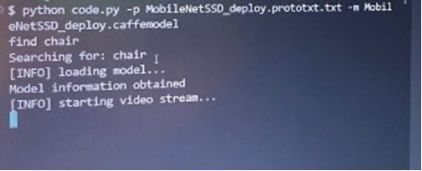
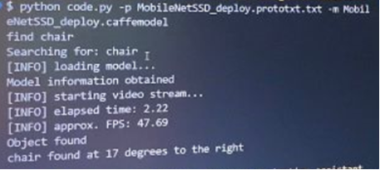
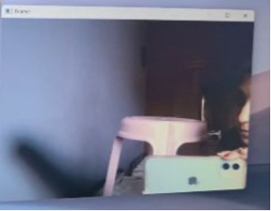
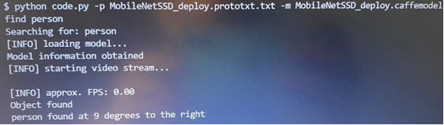
PART I
PART II

Slide 16
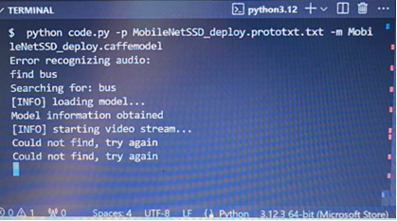
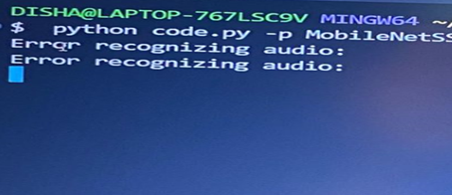
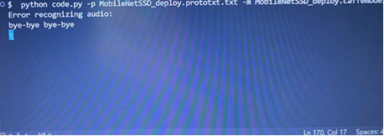
PART III
PART IV
PART V

Slide 17



REFERENCES
1. Abraham, C. H., Sakyi‐Badu, G., Boadi‐Kusi, S. B., Morny, E., Darko‐Takyi, C., Ocansey, S., ... & Kwasi Abu, E. (2024). Simulation of visual impairment in persons with normal vision for scientific research. Ophthalmic and Physiological Optics.
2. Saranya, V. S., Sonthi, V. K., Boyapati, P., Krishna, B. L. S. R., Ummadisetti, G. N., & Naresh, P. V. (2024). An Iot Machine Learning Approach for Visually Impaired People Walking Indoors and Outdoors. International Journal of Intelligent Systems and Applications in Engineering, 12(6s), 121-129.
3. Zhang, X., Pan, Z., Song, Z., Zhang, Y., Li, W., & Ding, S. (2024). The aerial guide dog: a low-cognitive-load indoor electronic travel aid for visually impaired individuals. Sensors, 24(1), 297.
4. Sahoo, S., & Choudhury, B. (2024). Exploring the use of computer vision in assistive technologies for individuals with disabilities: A review. Journal of Future Sustainability, 4(3), 133-148.
5. Acuña, K., Sapahia, R., Jiménez, I. N., Antonietti, M., Anzola, I., Cruz, M., ... & DeBuc, D. C. (2024). Functional Near-Infrared Spectrometry as a Useful Diagnostic Tool for Understanding the Visual System: A Review. Journal of clinical medicine, 13(1), 282.
6. Ricci, F. S., Boldini, A., Ma, X., Beheshti, M., Geruschat, D. R., Seiple, W. H., ... & Porfiri, M. (2023). Virtual reality as a means to explore assistive technologies for the visually impaired. PLOS Digital Health, 2(6), e0000275.
7. Makhataeva, Z., Akhmetov, T., & Varol, H. A. (2023). Augmented Reality for Cognitive Impairments. In Springer Handbook of Augmented Reality (pp. 765-793). Cham: Springer International Publishing.
8. Bredmose, A., Grangaard, S., Lygum, V. L., & Hansen, A. R. (2023). Mapping the importance of specific physical elements in urban space for blind and visually impaired people. Journal of Urban Design, 28(2), 139-154.
9. Soliman, I., Ahmed, A. H., Nassr, A., & AbdelRaheem, M. (2023, February). Recent Advances in Assistive Systems for Blind and Visually Impaired Persons: A Survey. In 2023 2nd International Conference on Mechatronics and Electrical Engineering (MEEE) (pp. 69-73). IEEE.
10. Koulouris, D., Trastelis, F., Menychtas, A., Kosmopoulos, D., & Maglogiannis, I. (2023, June). Utilizing AR and Hybrid Cloud-Edge Platforms for Improving Accessibility in Exhibition Areas. In IFIP International Conference on Artificial Intelligence Applications and Innovations (pp. 171-182). Cham: Springer Nature Switzerland.

Slide 18
REFERENCES
11. Raina, A. S., Mohanty, R. R., Bhuvanesh, A., Swaminathan, M., & Krishnamurthy, V. R. (2023). Pointing Tasks using Spatial Audio on Smartphones for People with Vision Impairments. Journal of Computing and Information Science in Engineering, 23(6).
12. Pundlik, S., Shivshanker, P., & Luo, G. (2023). Impact of Apps as Assistive Devices for Visually Impaired Persons. Annual Review of Vision Science, 9.
13. Mukhiddinov, M., Djuraev, O., Akhmedov, F., Mukhamadiyev, A., & Cho, J. (2023). Masked Face Emotion Recognition Based on Facial Landmarks and Deep Learning Approaches for Visually Impaired People. Sensors, 23(3), 1080.
14. Alqahtani, R. A., Alqahtani, R. S., Almutairi, Q. A., Aloqayli, R. M., & Alkasem, H. H. (2023, March). Ayn: Assistive Tool to Describe Images for Blind and Visually Impaired. In 2023 Sixth International Conference of Women in Data Science at Prince Sultan University (WiDS PSU) (pp. 25-30). IEEE.
15. Theodorou, P., & Meliones, A. (2023). Gaining insight for the design, development, deployment and distribution of assistive navigation systems for blind and visually impaired people through a detailed user requirements elicitation. Universal Access in the Information Society, 22(3), 841-867.
16. Masalkhi, M., Waisberg, E., Ong, J., Zaman, N., Sarker, P., Lee, A. G., & Tavakkoli, A. (2023). Apple Vision Pro for Ophthalmology and Medicine. Annals of Biomedical Engineering, 1-4.
17. Mai, C., Xie, D., Zeng, L., Li, Z., Li, Z., Qiao, Z., ... & Li, L. (2023). Laser Sensing and Vision Sensing Smart Blind Cane: A Review. Sensors, 23(2), 869.
18. Shan, R., Shi, W., Teng, Z., & Okada, Y. (2023, February). A Pedestrian Avoidance System for Visual Impaired People Based on Object Tracking Algorithm. In International Conference on Emerging Internetworking, Data & Web Technologies (pp. 375-385). Cham: Springer International Publishing.
19. Machado, F., Loureiro, M., Mello, R. C., Diaz, C. A., & Frizera, A. (2023). A novel mixed reality assistive system to aid the visually and mobility impaired using a multimodal feedback system. Displays, 102480.
20. Mina, P. N. R., Solon, I. M., Sanchez, F. R., Delante, T. K., Villegas, J. K., Basay, F. J., ... & Mutya, R. (2023). Leveraging Education through Artificial Intelligence Virtual Assistance: A Case Study of Visually Impaired Learners. International Journal of Educational Innovation and Research, 2(1), 10-22.

Slide 19



THANKYOU!
PRESENTED BY
Neha K Nayak
Disha Sriram

